Slide 1
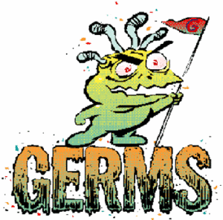

Slide 2
INVADERS!
Germs are tiny organisms, or living things, that can cause disease. Germs are so tiny that you need to use a microscope to see them. When they get in our bodies, we don't know what hit us until we have symptoms that say we've been attacked!
Germs are found all over the world, in all kinds of places. They can invade plants, animals, and people, and sometimes they make us sick.

Slide 3
There are many types of germs (bacteria & viruses) Some we can get in our bodies by breathing air that has germs in it when somebody has coughed or sneezed. We can get other germs into our bodies by touching something that has germs on it and then putting our hands or food into our mouths without washing.
Washing hands is the best way to fight germs!!

Slide 4
YOU SHOULD WASH YOUR HANDS WHEN YOU:
Use the toilet
Play with animals
Handle money
Cough, sneeze or blow your nose
Before preparing or touching food
Illnesses and diseases caused by bacteria and viruses can be very serious and may even cause death if not properly treated!

Slide 5
Germs are so small that you can’t see them!
There are many types of germs (bacteria & viruses)
Bacteria & viruses can cause illnesses & diseases such as : Upper & lower respiratory tract infections, influenza, pneumonia, hepatitis A & B and many others!
Washing hands is the best prevention!!

Slide 6
Viruses are a non-living collection of molecules that need a host to survive.

Slide 7
Bacteria are free-living cells that can live inside or outside a body.

Slide 8
WORD SCRAMBLE ANSWERS
1 .virus
2. twenty
3. warm
4. antibacterial
5. fingernails
6. four
7. vigorously
8. hand washing
9. bacteria
10. toilet

Slide 9
CROSS WORD ANSWERS!
Across: 1) hepatitis 3) vigorously 5) soap 6) toilet 7) fingernails
Down: 1) hand washing 2) warm 3) virus 4) bacteria 5) twenty

Slide 10
INFECTIONS & IMMUNIZATION
When our bodies are under attack from germs, our body has a defence system: our immune system. These tiny warriors fight against the invaders. Sometimes our immune system needs help recognizing the invaders, so we inject a very weak germ into our bodies (called an immunization or vaccination.) Our bodies can then fight against the real disease.

Slide 11
Sometimes we get cuts or injuries, and then germs get into that opening. We should wash it out right away to clean the germs out so that we don’t get an infection. OUCH!

Slide 12
We also get germs on our teeth from the food we eat. If there is sugar in the food, the “sugar bugs” or plaque attacks our teeth and makes holes called cavities. We have to visit the dentist to get a filling.

Slide 13
We can help our bodies to stay healthy by eating healthy foods and exercising. We know that there are four food groups: dairy, protein, grains and fruits & vegetables. We should eat some of each food group every day.

Slide 15
INFECTIOUS DISEASES SOMETIMES CAN’T BE BEATEN

Slide 16
The body’s guards are trained to fight certain kinds of viruses and each virus is fought back by different guards. When the guards win, they become stronger and even more numerous. That is why getting an immunization is very important.

Slide 17
The same thing happens when we have chicken pox or measles: we have guards (white blood cells) who are especially trained to fight off the germs that cause these diseases. The next time we are close to such germs, our guards are better prepared and have built up an even stronger defence.

Slide 18
Sometimes, our guards need a bit of help: the doctor gives us medicine to make our guards stronger and help them fight the disease.

Slide 19
Sometimes germs and viruses get into the body from accidentally poking the skin with a used needle. One such germ is called the HI virus, the virus which causes AIDS.
HIV stands for Human Immunodeficiency Virus. It is the disease you get which causes the illness AIDs.

Slide 20
The HI virus is very different from the ones discussed before:
• You cannot get the HI virus by touching someone or by being near someone who has it;
• You could get it if the blood of someone who has it entered your body. But chances of this happening are very slim, which means that the HI virus is quite difficult to get.
• Our guards cannot win against this virus. It is very strong and our guards become weaker and weaker as they try to fight it off. Then, they have trouble fighting off other kinds of germs and viruses.

Slide 21
• There is no medicine yet to help our guards fight the HI virus.
• Because the HI virus stops your immune system from working, when other diseases come along, your body is defenseless. This is what we call AIDS. You will get those diseases and your body will eventually stop working properly and die.
• AIDS stands for Acquired Immune Deficiency Syndrome

Slide 22
It is a good thing we know how to prevent germs and viruses from entering our blood (do not play with sharp objects, including needles, and avoid other people’s bodily fluids). After all, it is always a good idea to learn of ways to keep germs and viruses from entering our bodies, even the ones our bodies can fight off. That way, we give our guards a rest.

Slide 23
WHAT IS CANCER?

Slide 24
HOW MANY TYPES OF CANCER DO YOU THINK THERE ARE?
Sample
text
There are over 200 types of cancer

Slide 25
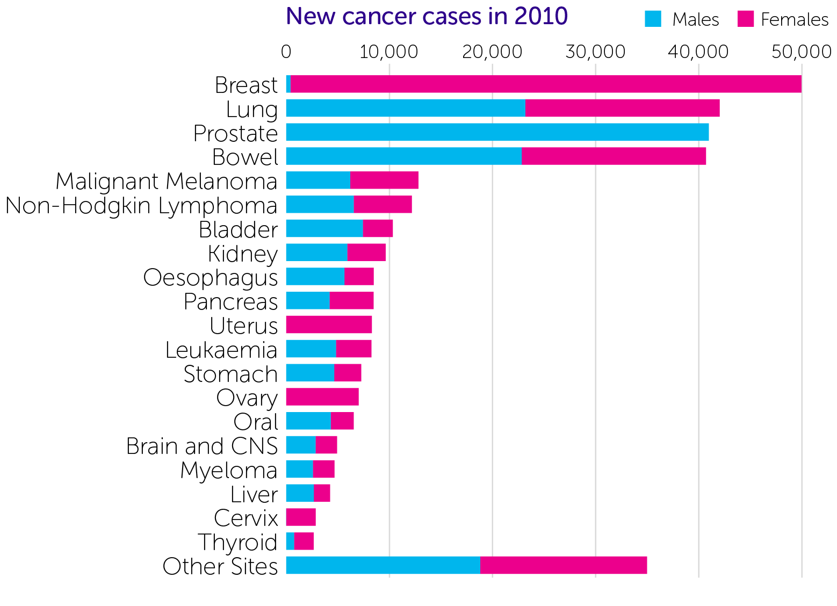
COMMON CANCERS
*
*Includes malignant brain and central nervous system tumours.

Slide 26
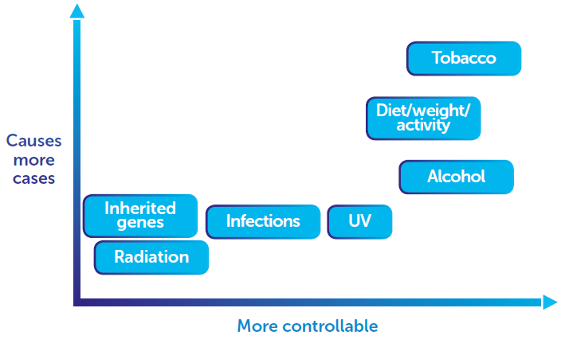
WHICH CAUSES OF CANCER CAN YOU CONTROL?

Slide 27
WHICH CAUSES OF CANCER CAN YOU CONTROL?
Sample
text

Slide 29
The cell has a control center called a nucleus. Inside this nucleus is your DNA: the information needed to build your body and keep it going.
Your cells grow and multiply continually. Each cell has to go through a series of checkpoints (like traffic lights) which check that the cells are healthy.

Slide 30
Sometimes the DNA in the cells gets damaged. This can happen because of mistakes in your cell or sometimes things in our lifestyle, like smoking, drinking alcohol, being overweight, eating an unhealthy diet, lack of exercise or over exposure to the sun.

Slide 31
Usually cells that are damaged are removed at these check points, and the body destroys them. Unfortunately, sometimes one or two slip though and copy themselves, causing a tumor, which is the start of cancer.

Slide 32
If the cancer cells enter the blood system and travel around the body, sometimes they start growing in other places too. It is much easier to treat cancer before they spread around.

Slide 33
QUIZ
Sample
text
1. Cancer is generally a disease of...
Old age
Childhood
Middle age

Slide 34
QUIZ
Sample
text
2. How does cancer develop?
You can catch it from someone
When cells divide out of control
From a blood transfusion

Slide 35
QUIZ
Sample
text
3. How many types of cancer are there?
20
200
2000

Slide 36
QUIZ
5. Name the 4 most common cancers in the UK
Breast
Lung
Prostate
Bowel

Slide 37
QUIZ
6. TRUE OR FALSE?
There are many things within our control that can help reduce the risk of cancer...
TRUE
A healthy lifestyle isn’t a guarantee against cancer, but it can help to stack the odds in your favour

Slide 38
QUIZ
7. TRUE OR FALSE?
It is possible to inherit genes from your parents that make you more likely to develop a certain type of cancer?
TRUE
But this doesn’t necessarily mean you will get cancer. It just means you’re at higher risk

Slide 39
QUIZ
Sample
text
8. TRUE OR FALSE?
Cell division is a natural process, needed for the growth, repair and replacement of cells in the body...
TRUE
But if it gets out of control, cancer can develop

Slide 40
QUIZ
9. TRUE OR FALSE?
Using deodorants can increase the risk of developing cancer...
FALSE
This rumour was started by an email hoax and has no scientific evidence to support it

Slide 41
QUIZ
TRUE
Being active is a great way to help reduce the risk of bowel, breast and womb cancers.
Aim for about 60 minutes a day
10. TRUE OR FALSE?
Being physically active can reduce the risk of cancer...

