Slide 1
SURVIVAL

Slide 3
Doctors have concluded that if you find the man in the coffee beans in 3 seconds, your right half of your brain is better developed than most people. If you find the man between 3 seconds and 1 minute, your right half of the brain is developed normally. If you find the man between 1 minute and 3 minutes, then the right half of your brain is functioning slowly and you need to eat more protein. If you have not found the man after 3 minutes, the advice is to look for more of this type of exercise to make that part of the brain stronger!!! And, yes, the man is really there!!!

Slide 4
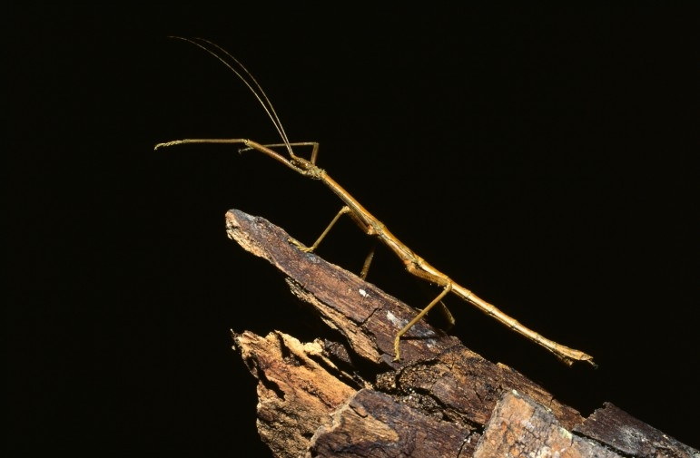
SURVIVAL IN THE ENVIRONMENT
For some organisms, appearance helps them to survive.

Slide 11
STRUCTURAL ADAPTATIONS
Some creatures have physical features which help them survive in their environments (like wings, teeth, webbed feet, etc)

Slide 14
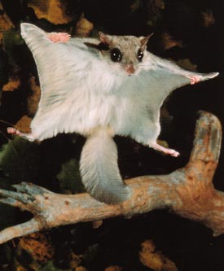

Slide 16
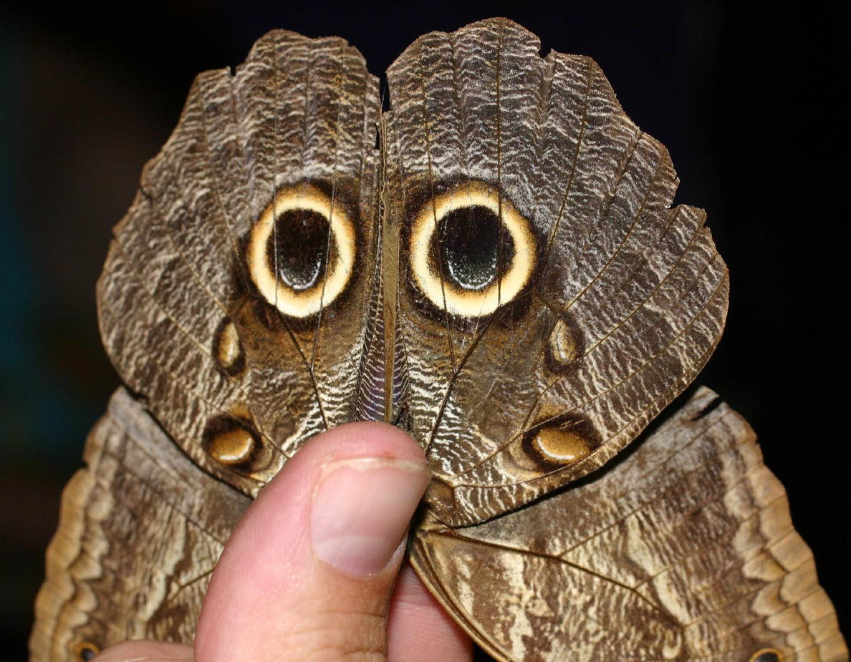
MIMICRY
Some organisms imitate other creatures to scare off predators or lure in prey.

Slide 18
WARNING!!
Some organisms have bright colours to warn predators that they are poisonous and should be left alone!

Slide 20
POLLINATION
Many plants need insects to pollinate them, so they are bright colours or attractive fragrances to attract insects.

Slide 21
FOR YOU TO DO:
Pg. 51 in your texts “WORK ON IT” Section at the bottom of the page
Take a look at pg. 52
From just looking at the pic (not reading the caption) – try to guess the adaptation of each animal
Now with your partner, read the caption and see if you were right! List the adaptations as structural or behavioural.

