Slide 1
THE MICROSCOPIC WORLD

Slide 2
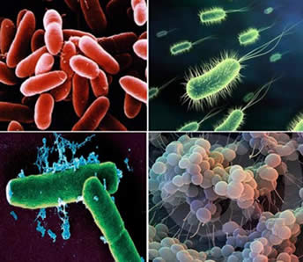
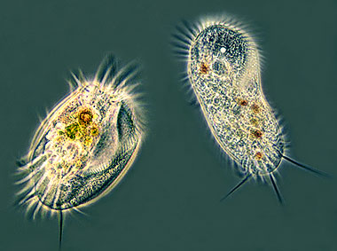
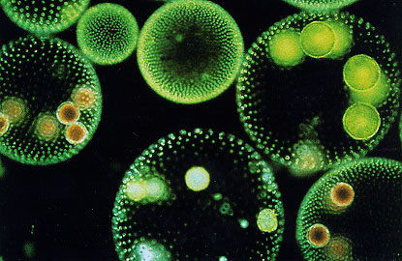
THE MICROSCOPIC WORLD
Living things come in all shapes and sizes and live everywhere in the world. A group of living things that we don’t see are micro-organisms. They are so small you need a microscope to see them!

Slide 3
Scientists classify micro-organisms by how their body structures work (the ones that are more like plants or animals or fungus). The fancy name for most micro-organisms is protozoa. Protists are like all other living things: they respire, need energy to live, respond to stimuli, grow, reproduce and excrete waste.

Slide 4
Bacteria are also micro-organisms, but they are different enough to be in their own category called monera.

Slide 5
WHY ARE MICRO-ORGANISMS IMPORTANT?
There are billions of micro-organisms, and some are good and others are bad. If you have ever been sick, you can probably blame a micro-organism (we call them germs!). But micro-organisms do some helpful things too! We can make medicine, foods like yogurt, and some help us digest our food. We use microorganisms to cook (yeast, vinegar, cheese) Others help plants grow or break down rotting plants or animals.

Slide 6
Unfortunately, humans have also used micro-organisms as weapons: spreading horrible diseases or contaminating food.
Disease causing organisms can be spread in various ways:
1) Person to Person :(by sneezing, coughing, saliva and blood)
2) Food: (bacteria in food that hasn’t been cooked or refrigerated properly can cause food poisoning)
3) Water: Protozoa can live in all kinds of water, and if you drink contaminated water, you can get very sick and even possibly die.

